Slide 1
Control Board to Accelerometer Cable

Slide 2
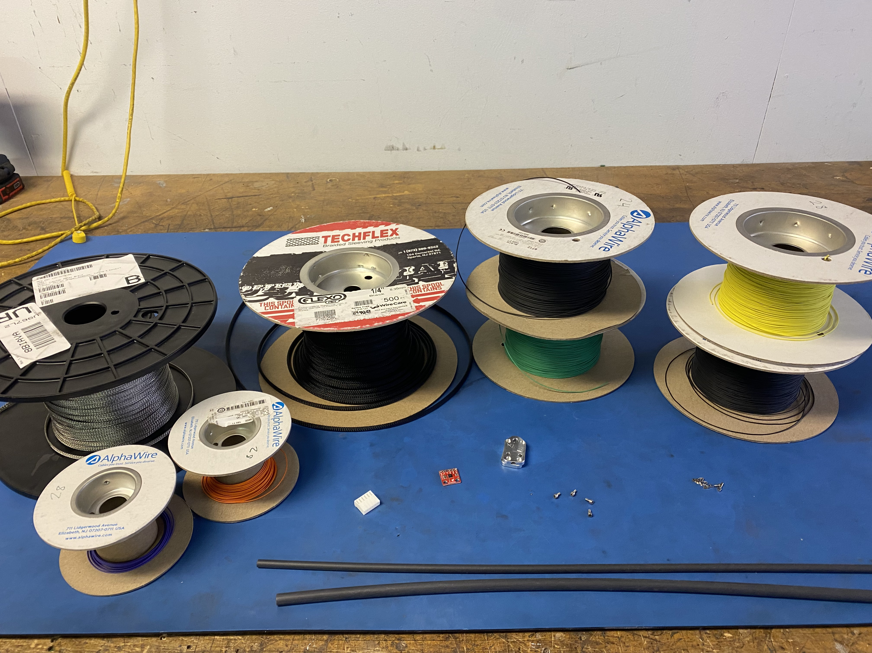
Materials

Slide 3
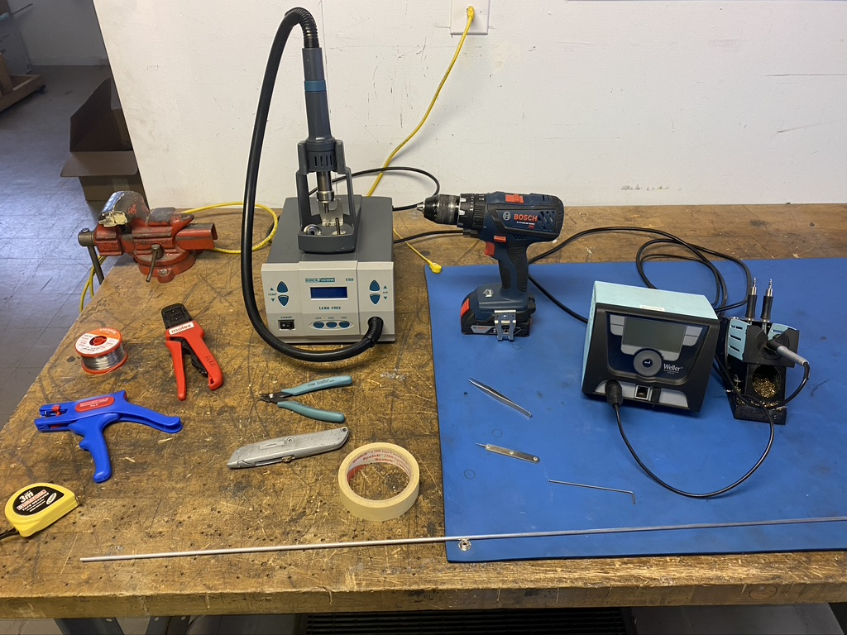
Tools

Slide 4
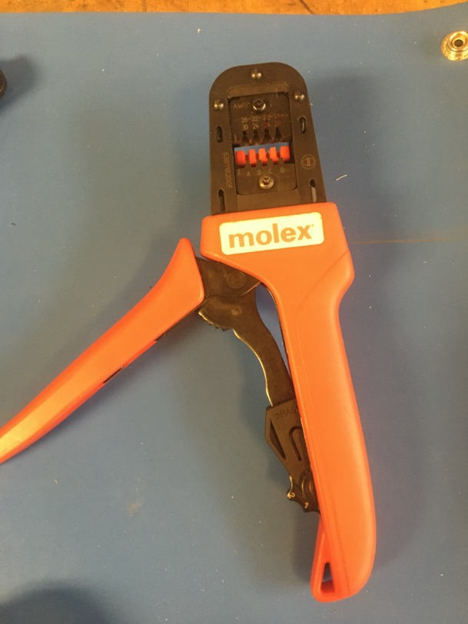
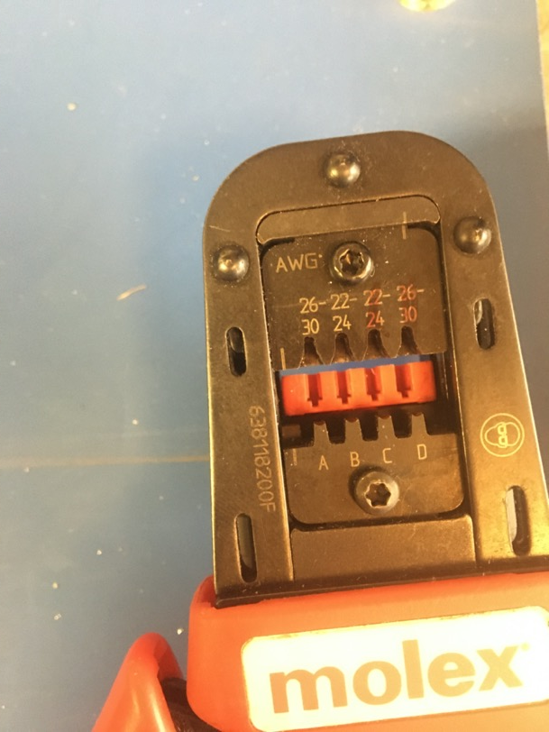
KK 254 Crimping Tool

Slide 5
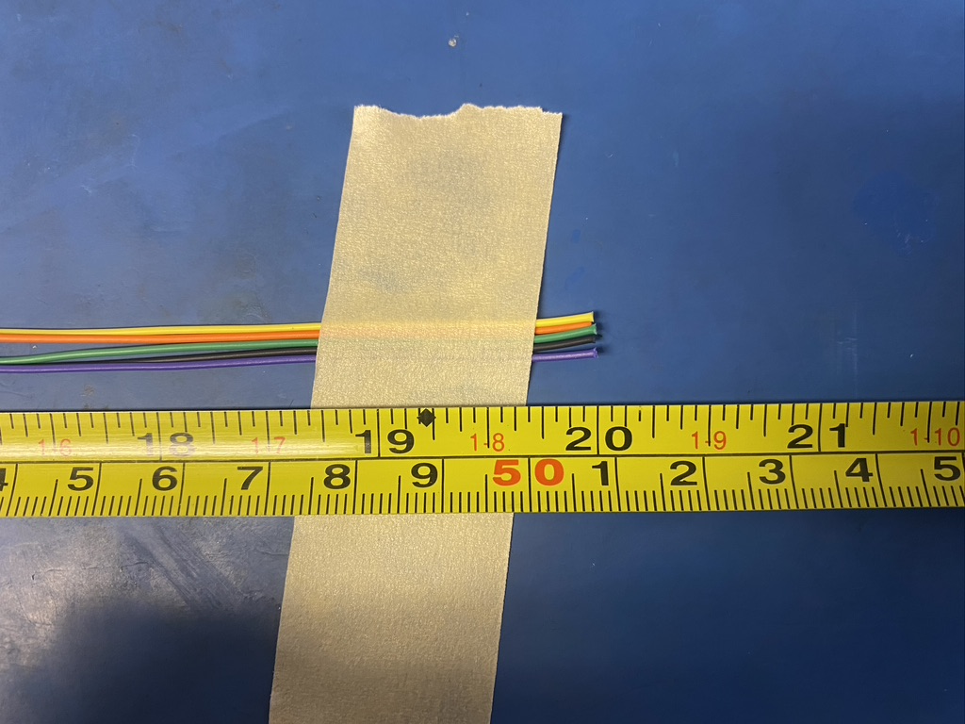
Measure out and cut 20 inches of yellow, orange, green, violet, and black 28 awg wire.

Slide 6
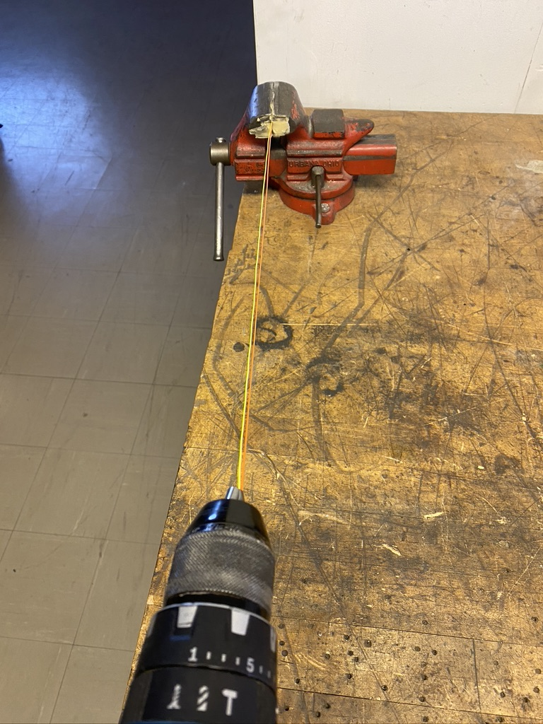
To make the twisted pairs, line the vise with masking tape. Put one end of the yellow and orange wires into the drill. Run the drill till the wires are sufficiently twisted (for reference see the next slide). Repeat with the black and green wires.

Slide 7
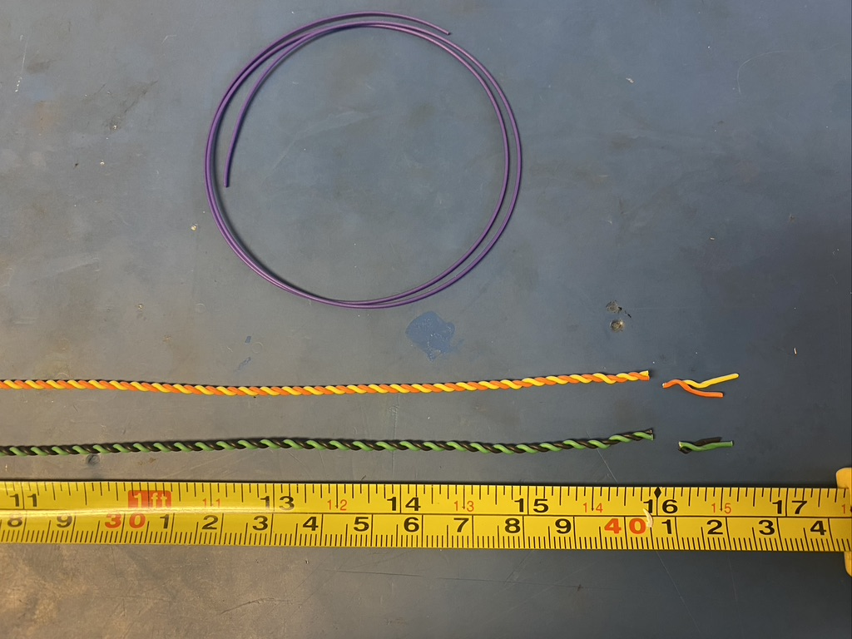
Trim the ends of each twisted pair where they were in the vise and drill. Once trimmed, they should measure about 16 inches.

Slide 8
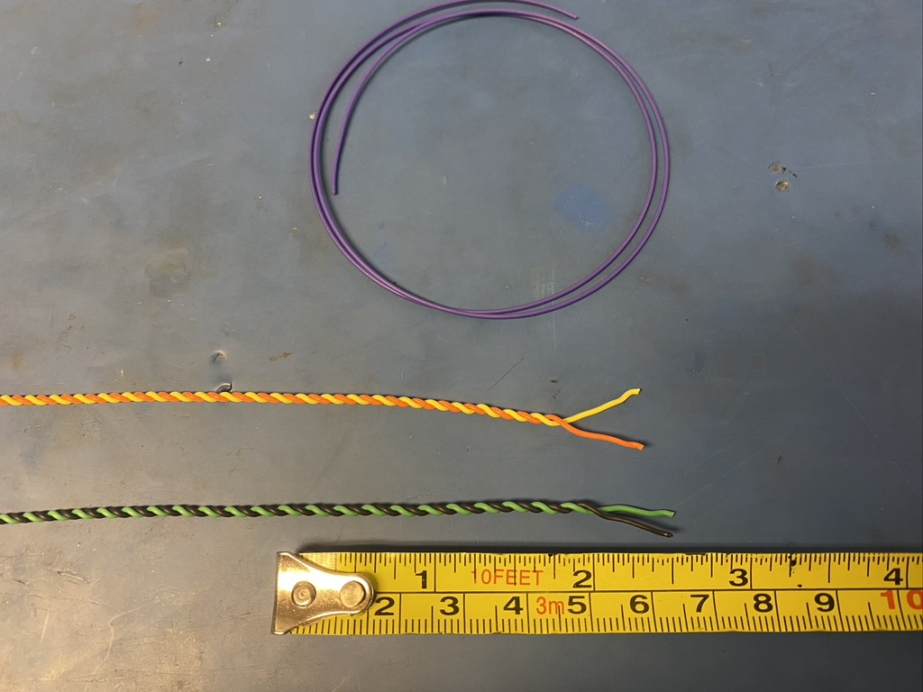
Untwist about .5in of one end of the twisted pairs.

Slide 9
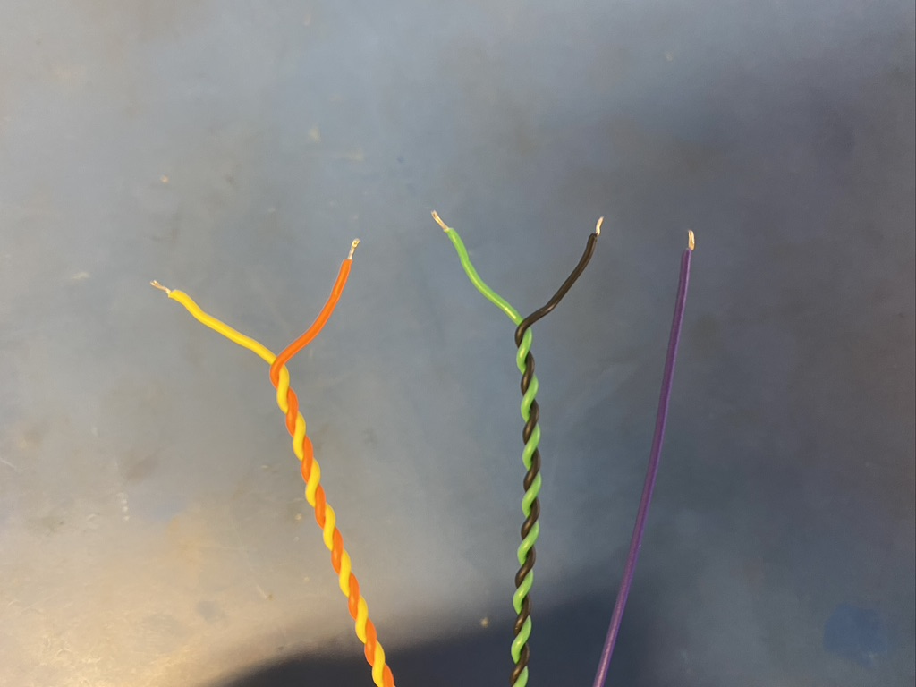
Strip all the wires (about 2mm).

Slide 10
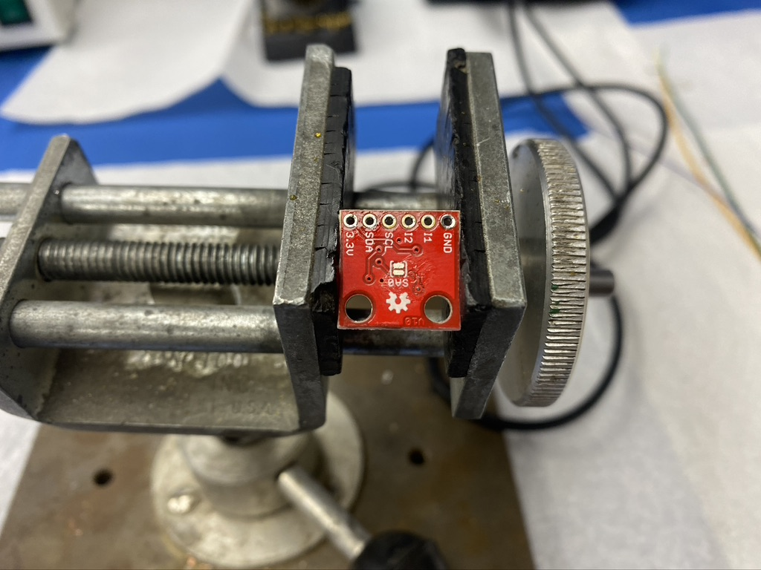
Place the accelerometer in the vice as shown below.

Slide 11
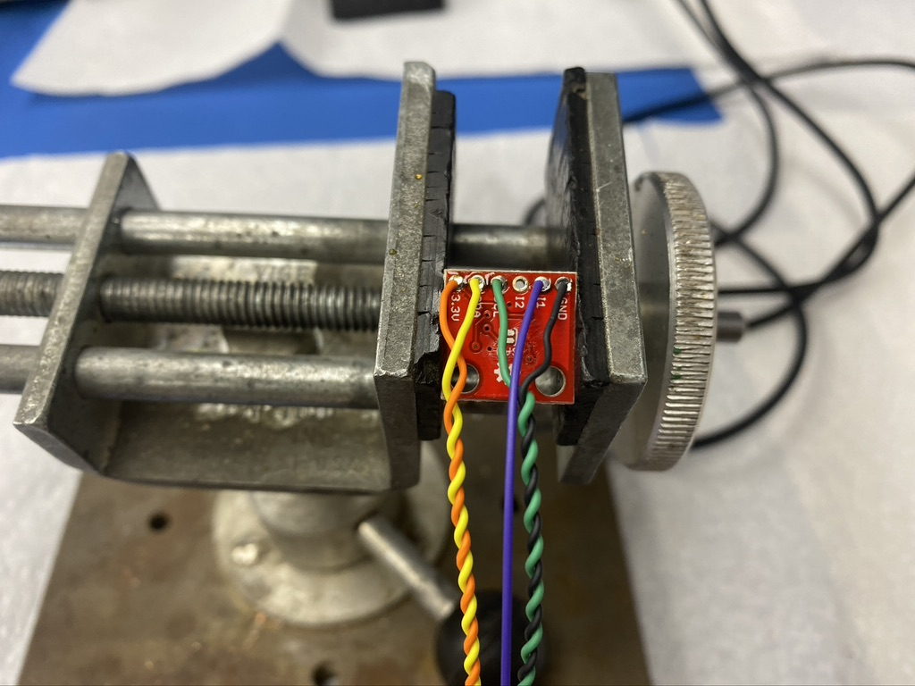
Solder the wires onto the chip as shown.

Slide 12
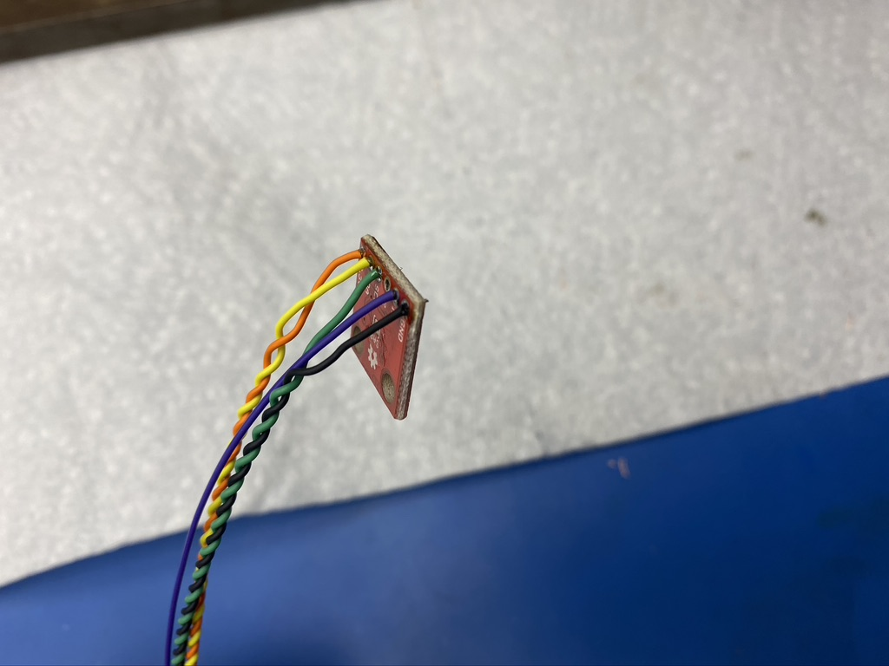
The wires should be soldered such that the isolation should be touching the chip.

Slide 13
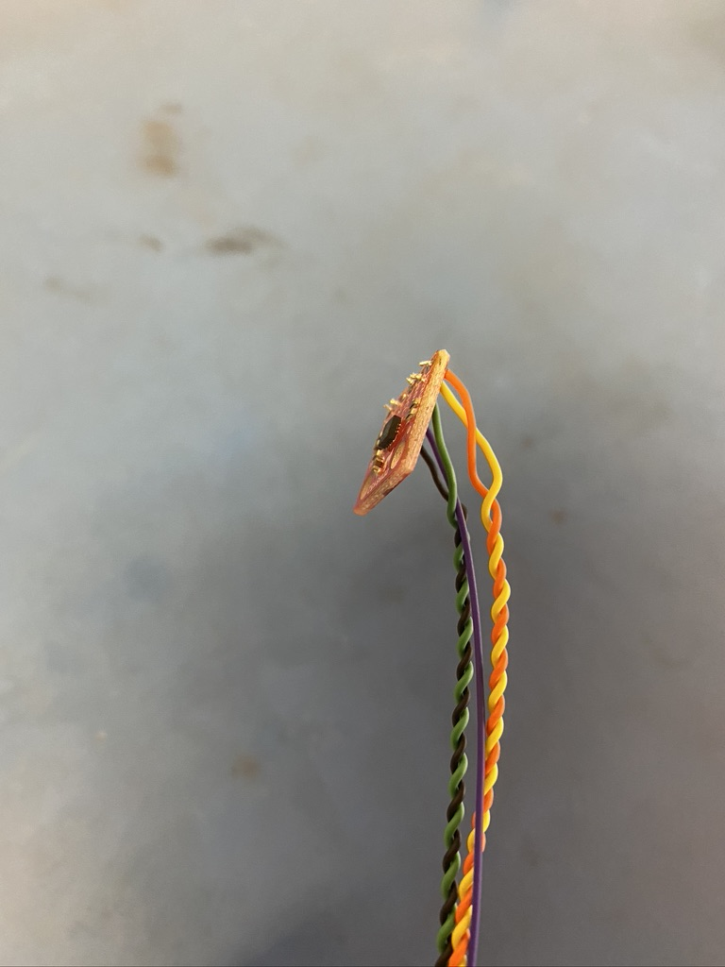
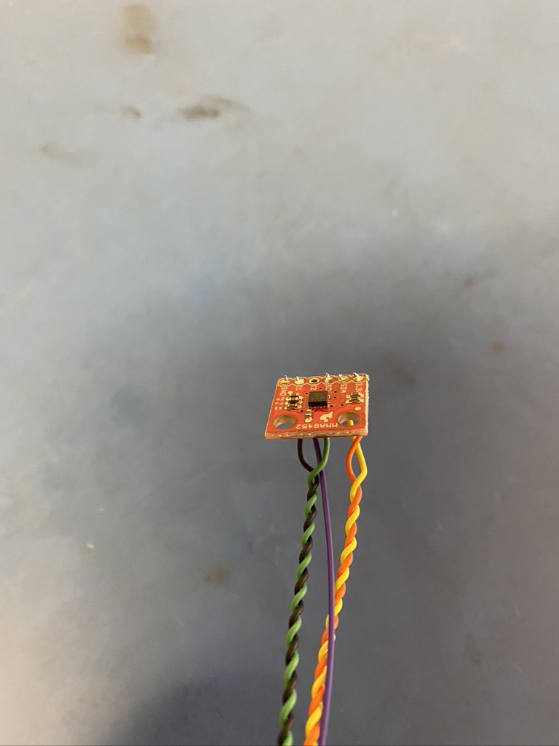
After soldering, the wires will likely stick out of the holes on the other side of the chip.

Slide 14
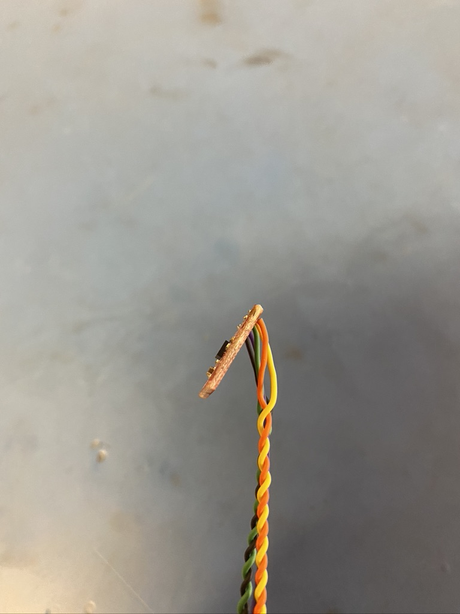
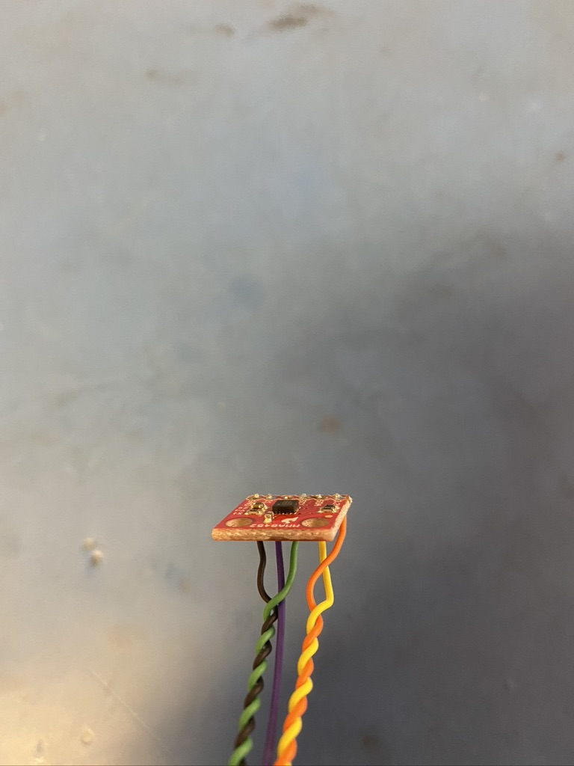
Trim the ends of the wires with the side cutters so they don’t stick out. This is important because if left long, the wires could short to the metal enclosure that will surround the chip.

Slide 15
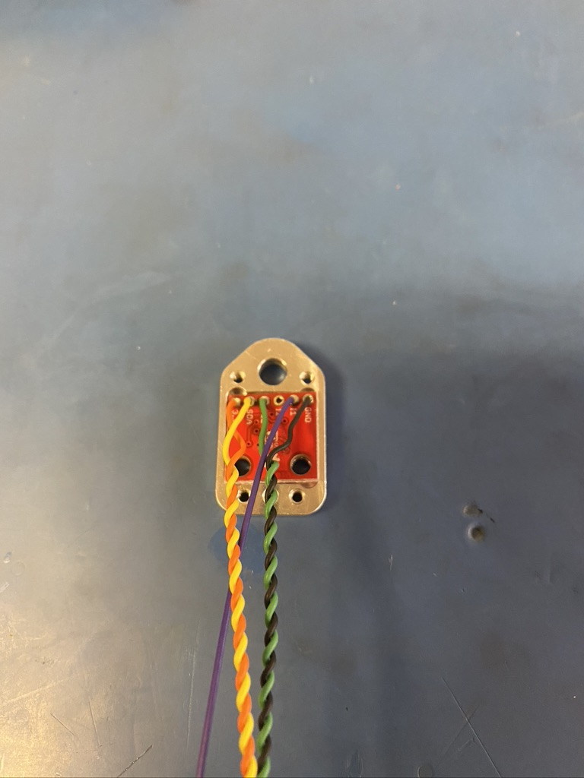
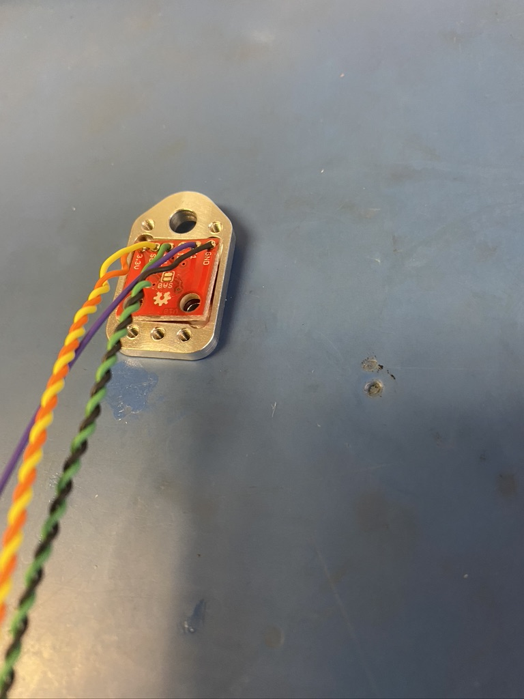
Trying to place the chip into the metal enclosure, it can be seen that the chip is slightly too big. As a result, the chip needs to be filed down slightly.

Slide 16
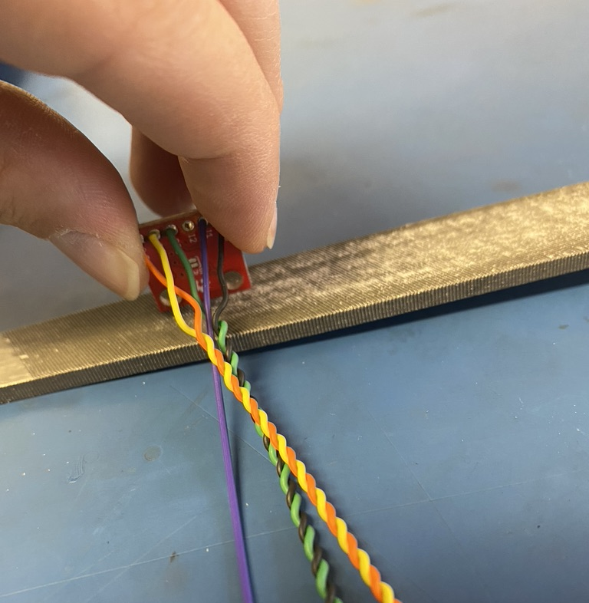
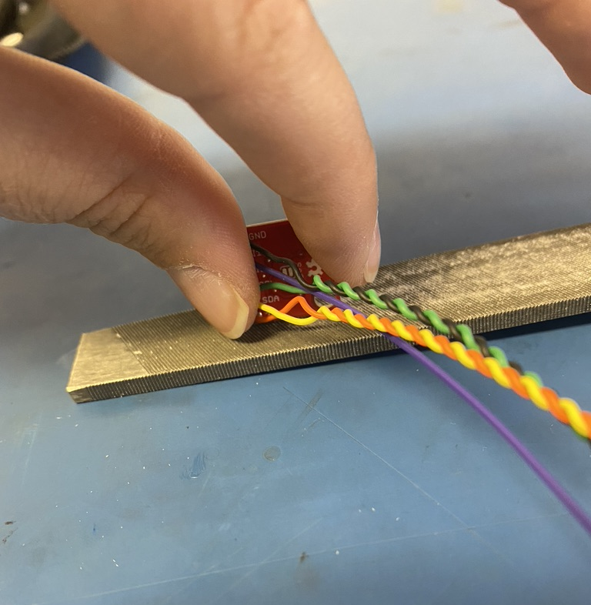
File down both the length and height of the chip. The length (as shown in the photo on the left) will need to be filed down more than the height. Don’t file the chip too much. The fit in the metal enclosure should be tight.

Slide 17
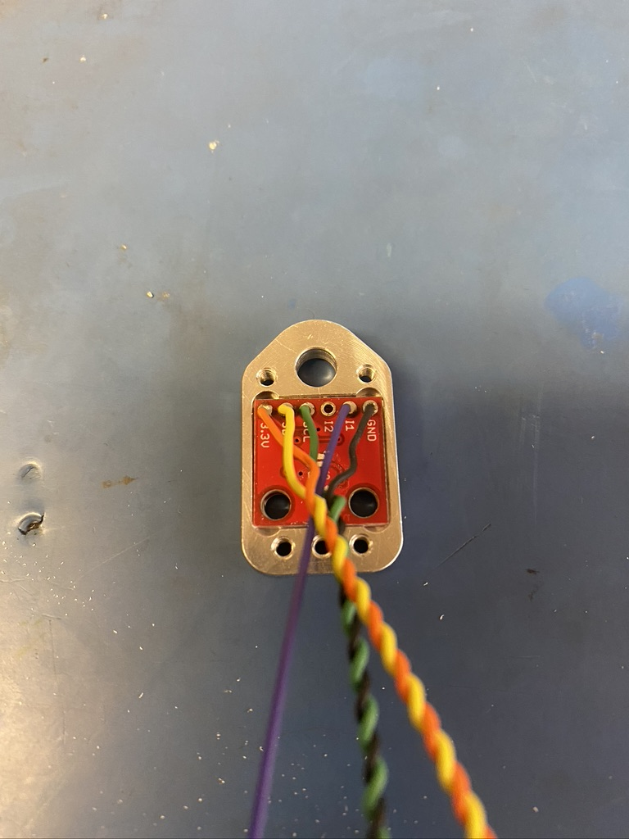
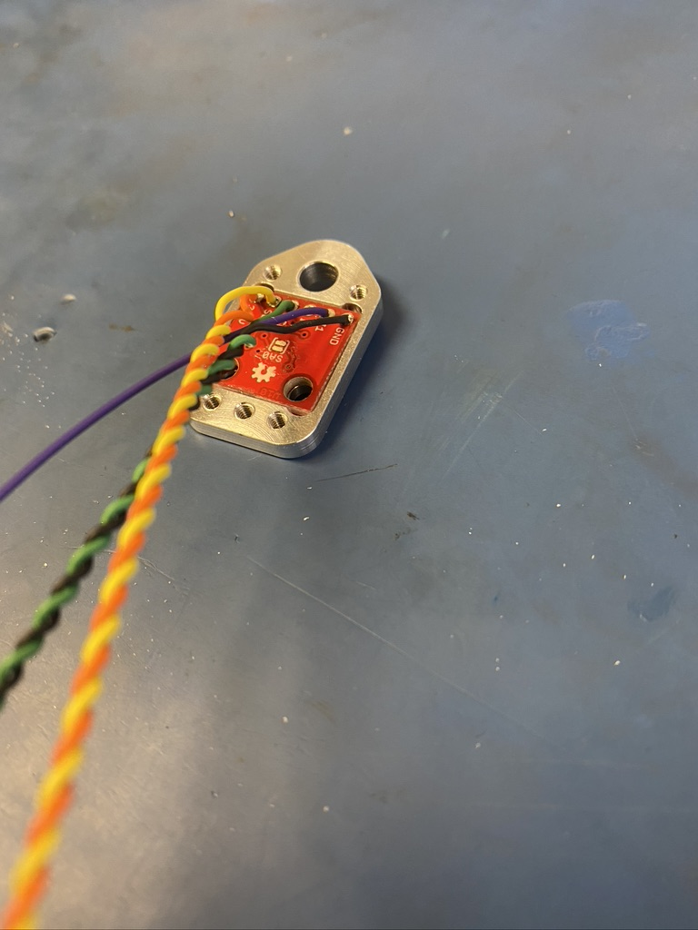
Once filed, the chip should fit into the metal enclosure. The fit should be tight else it won’t work well as an accelerometer.

Slide 18
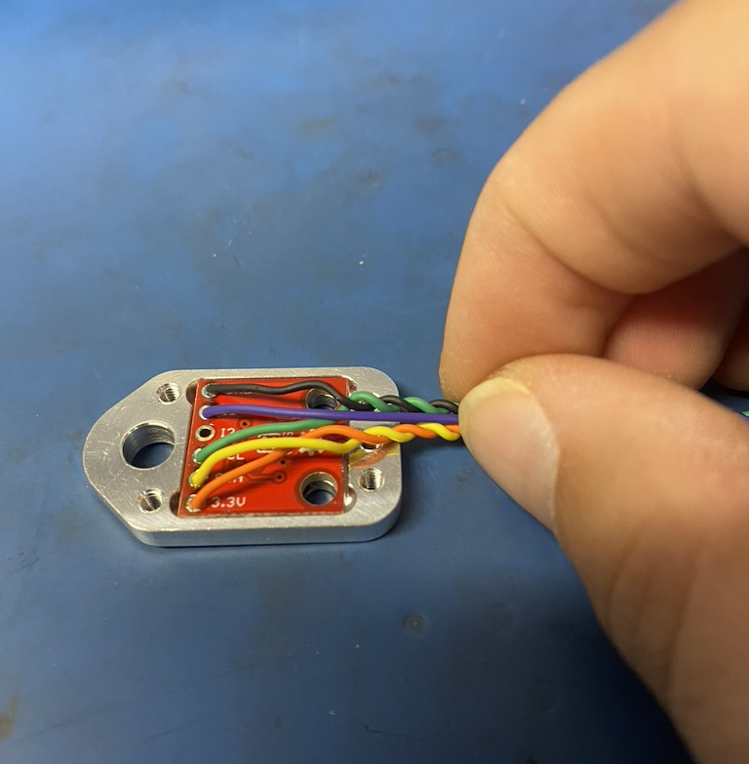
Untwist the twisted pairs to the edge of the chip.

Slide 19
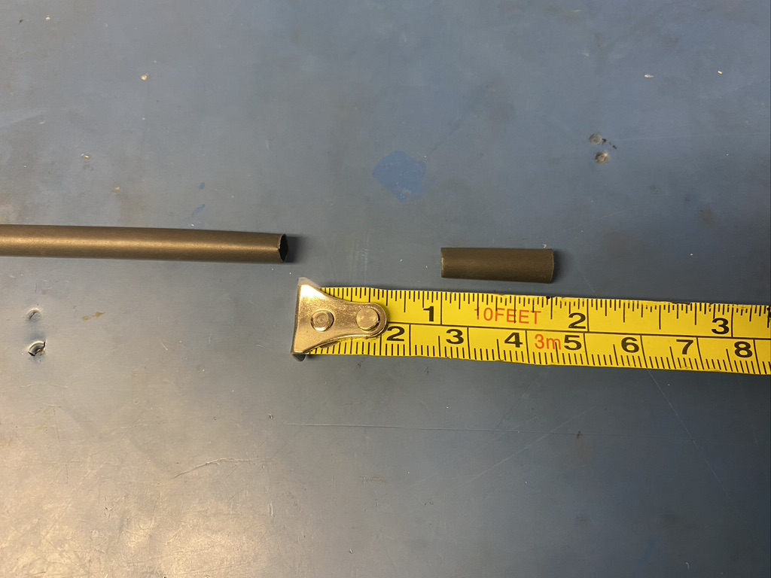
Measure out and cut one length of 4.8mm adhesive shrink tube that is .75in long.

Slide 20
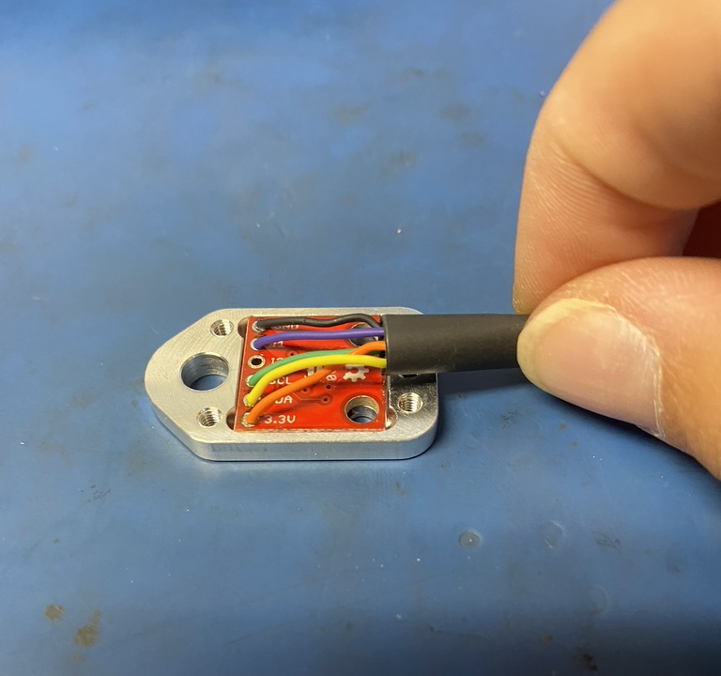
Put the the piece of shrink tube onto the end of the wire and slide it all the way to metal enclosure. Place it so the end lines up with the bottom edge of the accelerometer chip.

Slide 21
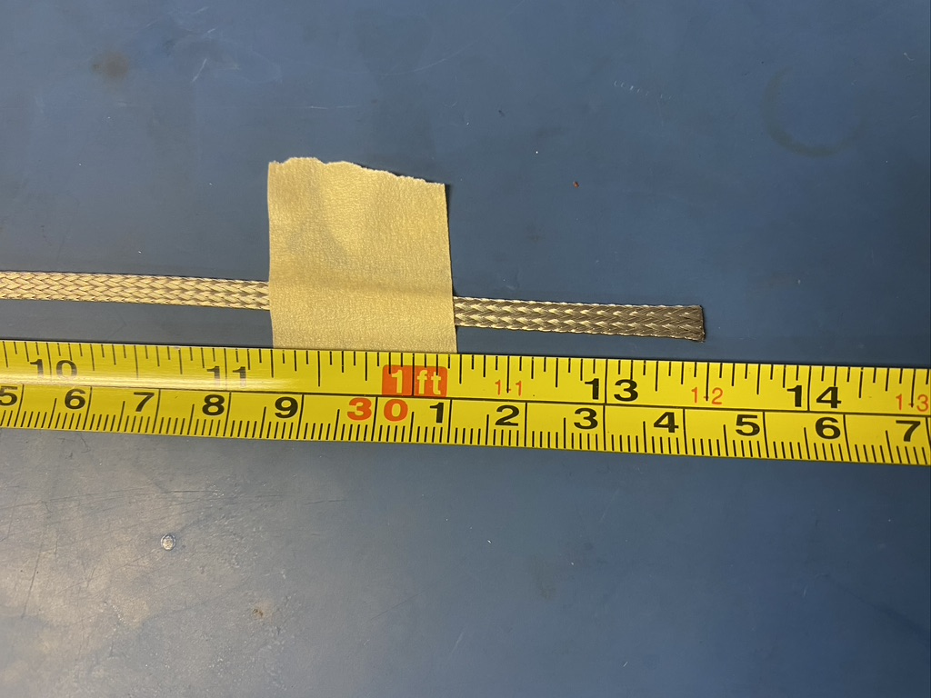
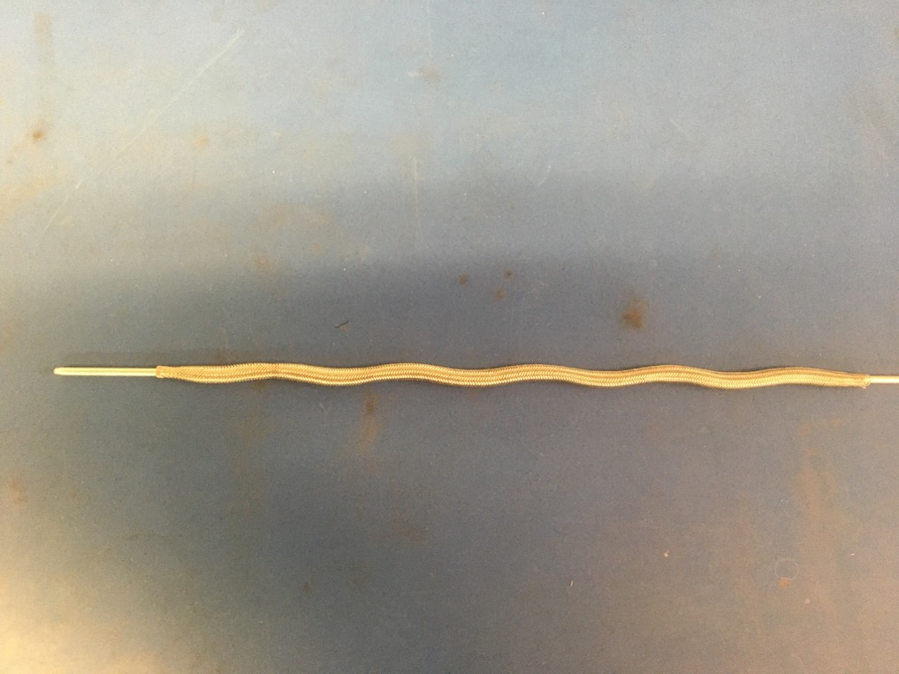
Measure out 13.5 inches of the 1/8th metal braid. Expand it using the metal rod.

Slide 22
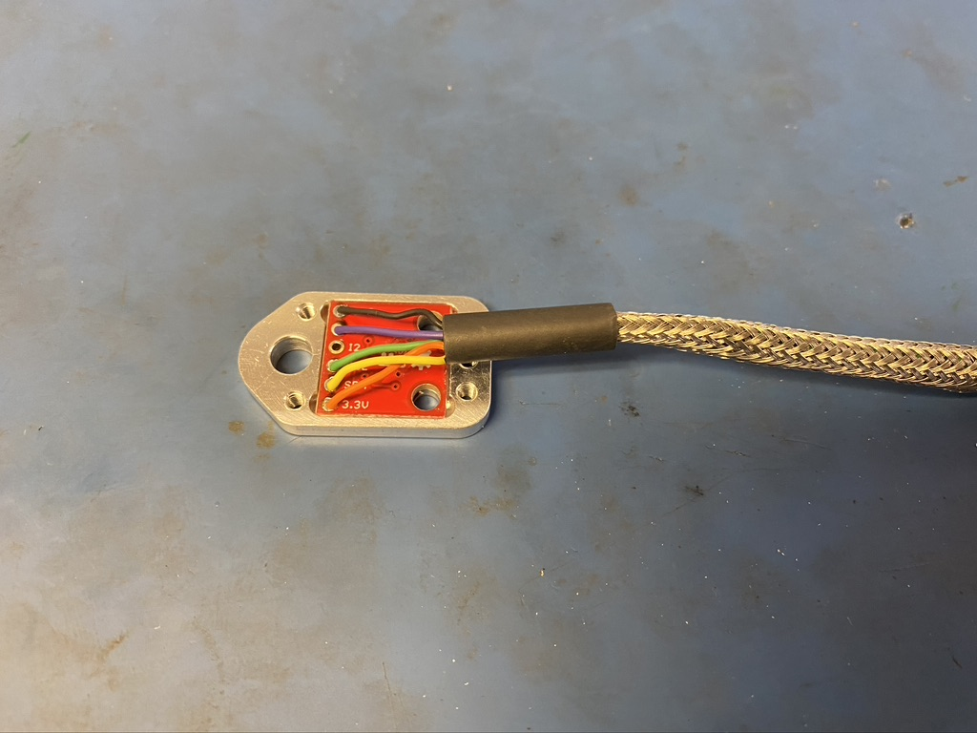
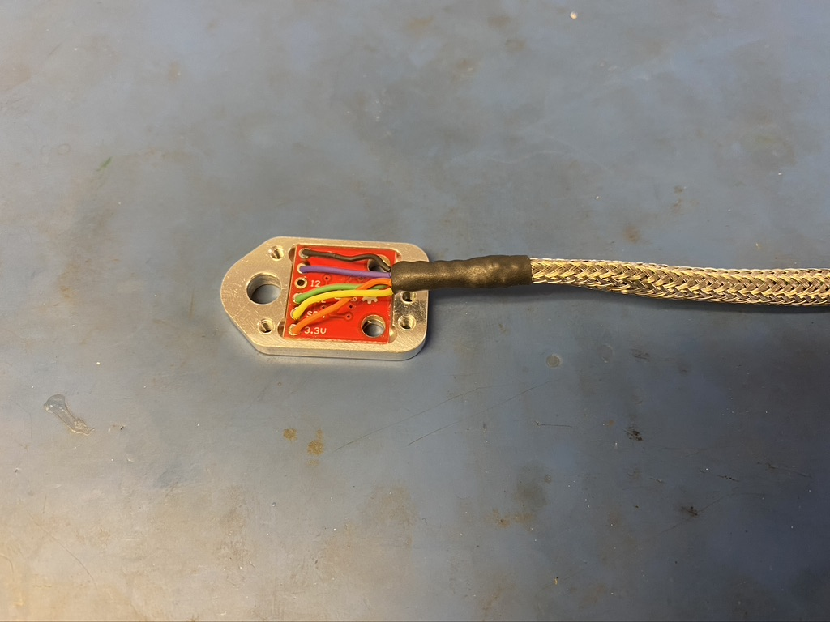
Thread the metal braid onto the the ends of the wires and push it all the way up to the metal enclosure. Put the metal braid into the piece of shrink tube. The metal braid should end slightly before it reaches the metal enclosure in the shrink tube.

Slide 23
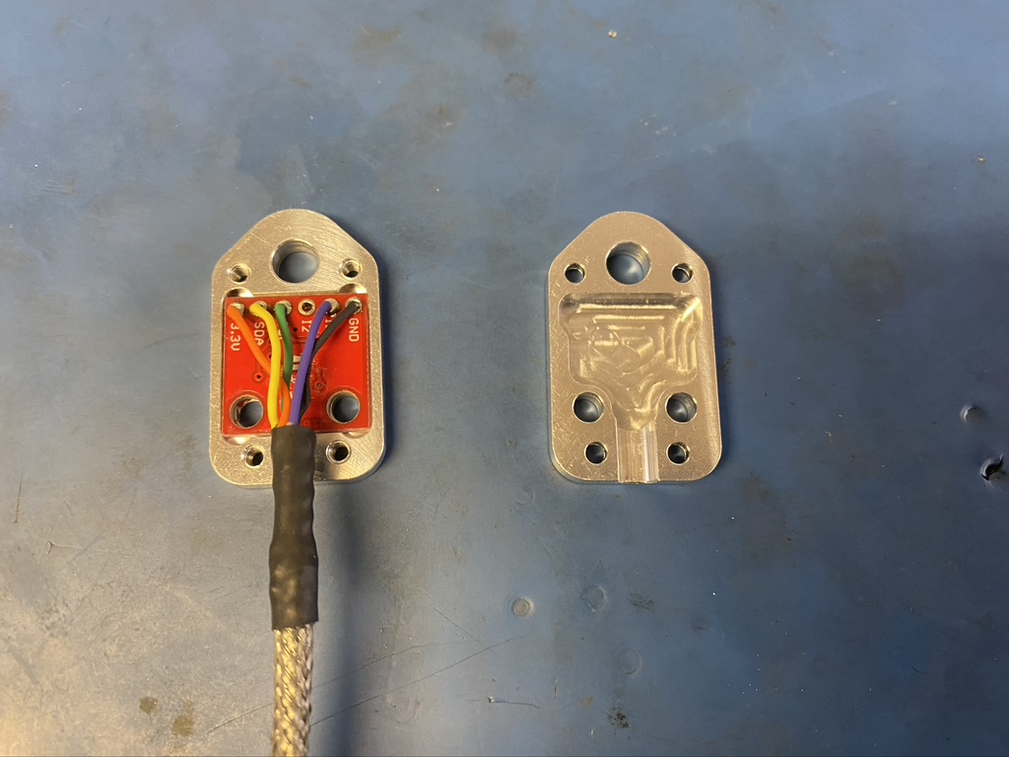
Shape the wires attached the accelerometer chip so that they will fit inside the other half of the enclosure. This can be done by gathering them into a V-shape as shown in blue.

Slide 24
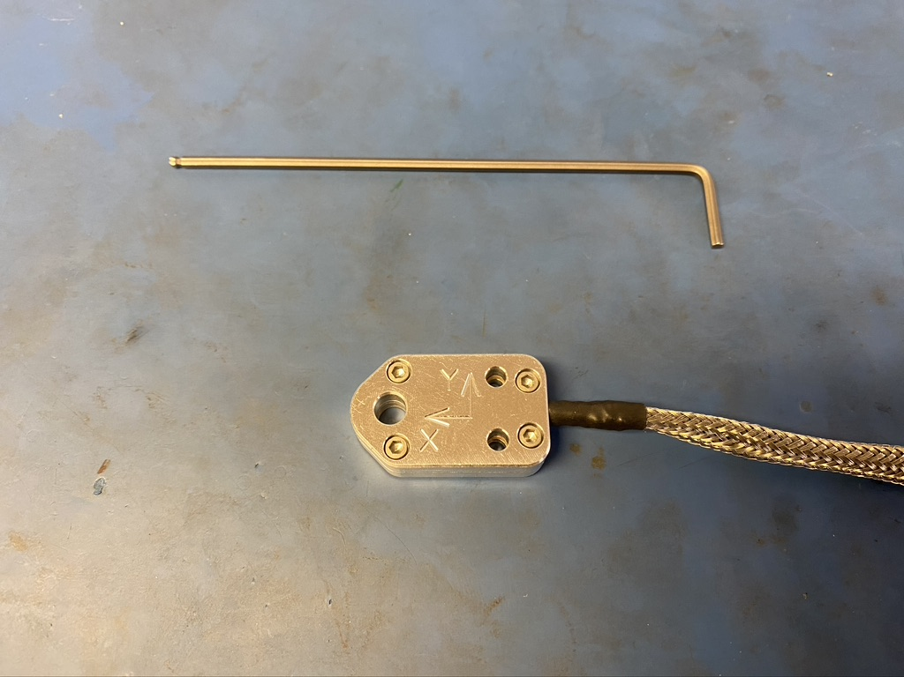
Close the metal enclosure. Be sure it does so easily else there maybe a wire that isn’t placed properly and is getting crushed. Secure the two halves of the enclosure together with four 2-36 x 3/16 screws and a 5/64ths allen wrench.

Slide 25
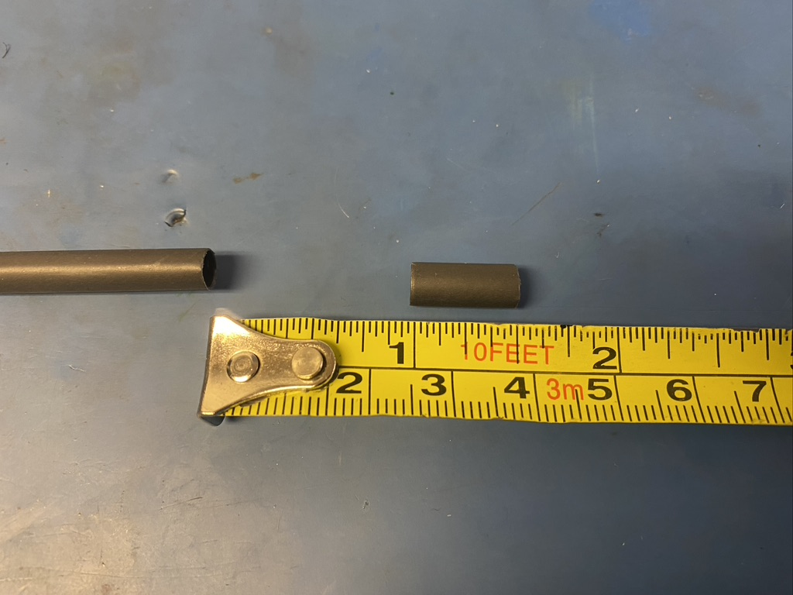
Measure out and cut one length of 4.8mm adhesive shrink tube that is .5in long.

Slide 26
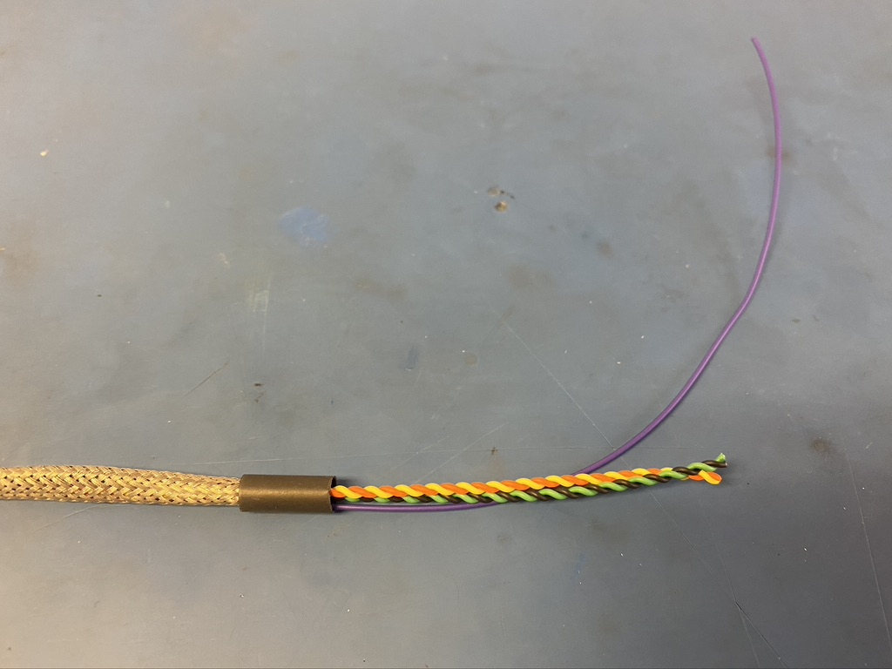
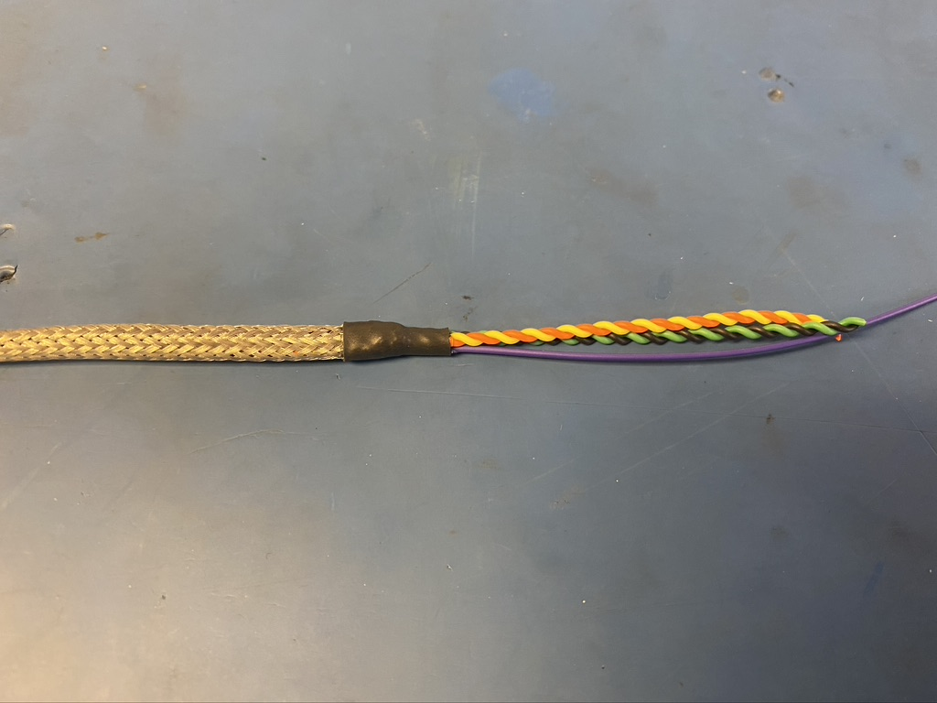
Put another piece of the 4.8mm shrink tube onto the other end of the metal braid. Again, the metal braid should end midway through the piece of shrink tube. Apply the heat gun.

Slide 27
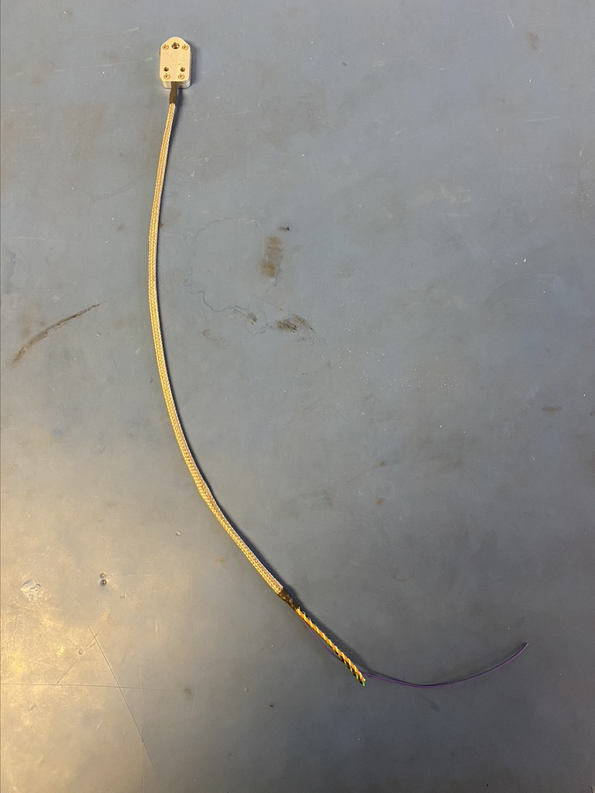
So far, the wire harness should appear as shown on the left.

Slide 28
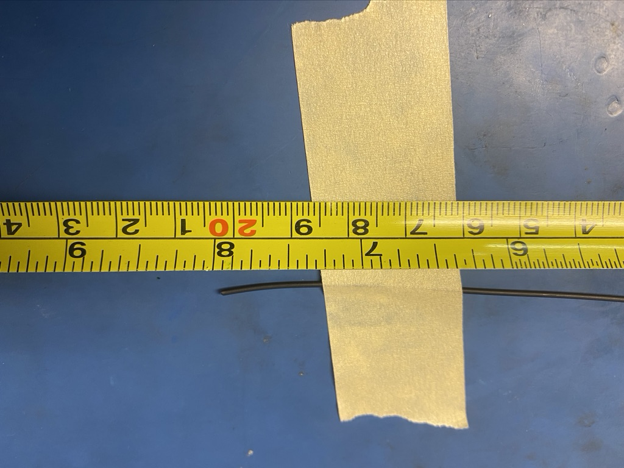
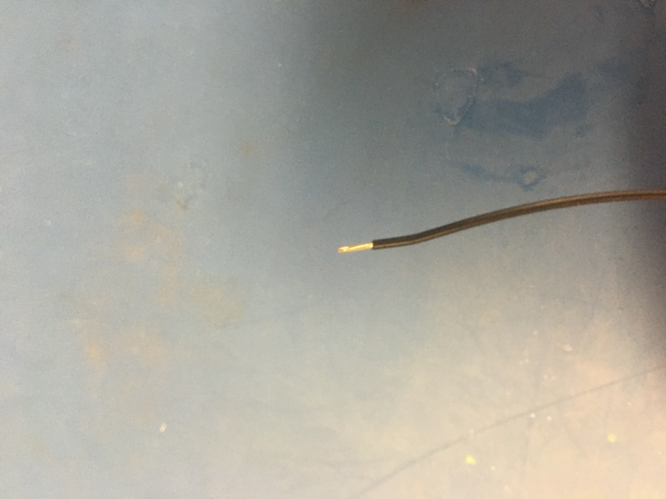
Measure out and cut 8 inches of black 24 awg wire. Strip 3-4mm off one end.

Slide 29
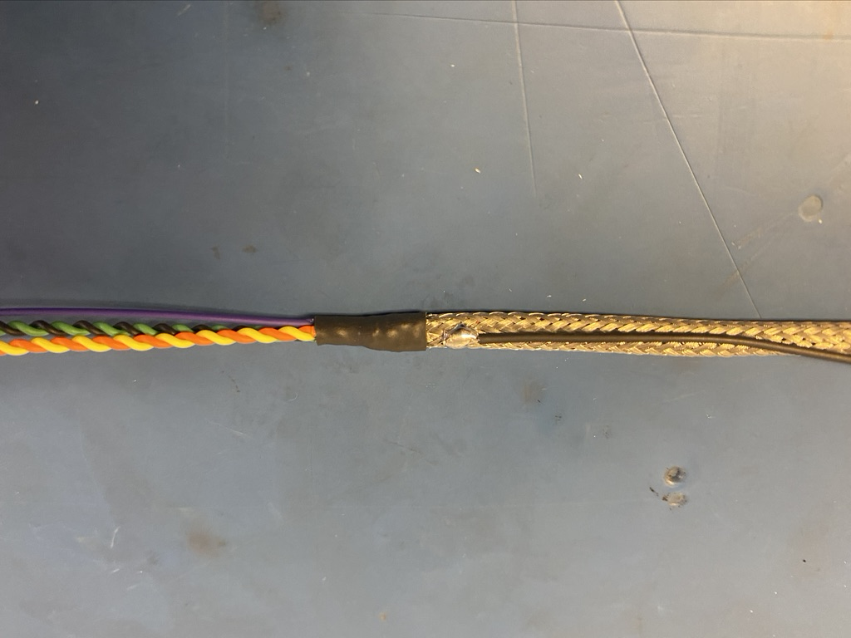
Solder the stripped end of the black wire onto the metal braid near the shrink tube joint at end of the harness. The black wire should be soldered so the that its length runs with that of the metal braid.

Slide 30
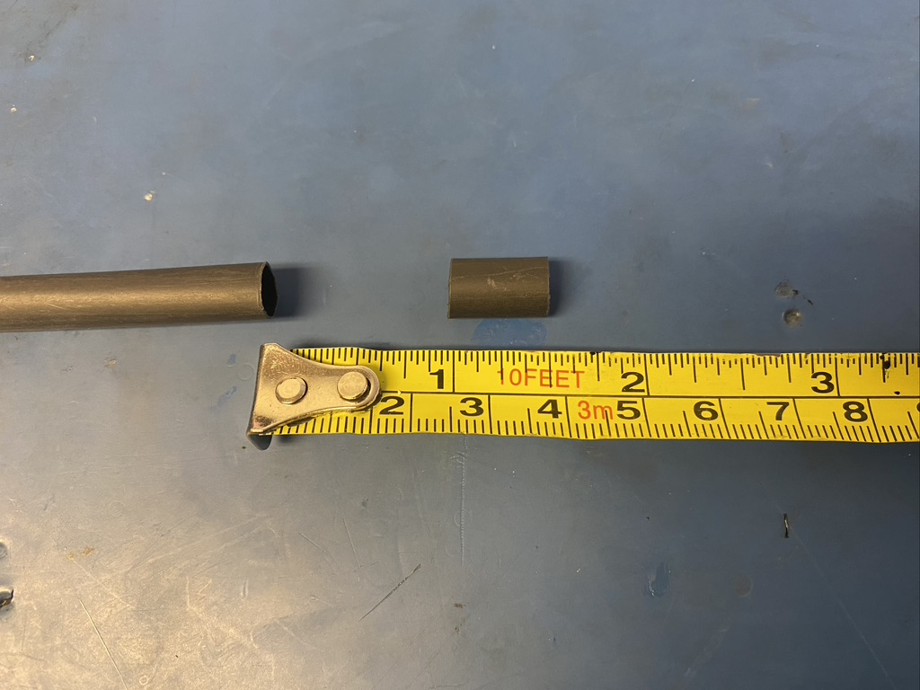
Measure out and cut one length of 6.4mm adhesive shrink tube that is .5in long.

Slide 31
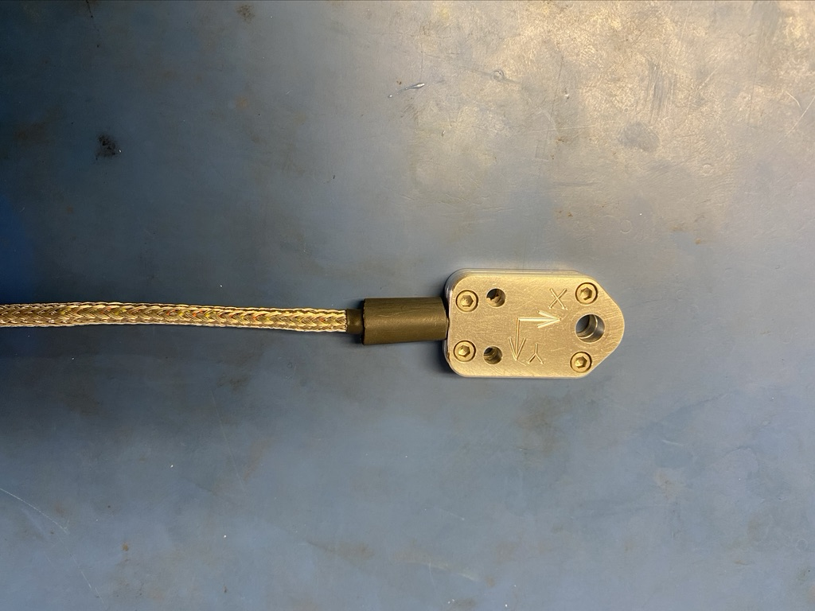
Put the piece of shrink tube onto the wire harness.

Slide 32
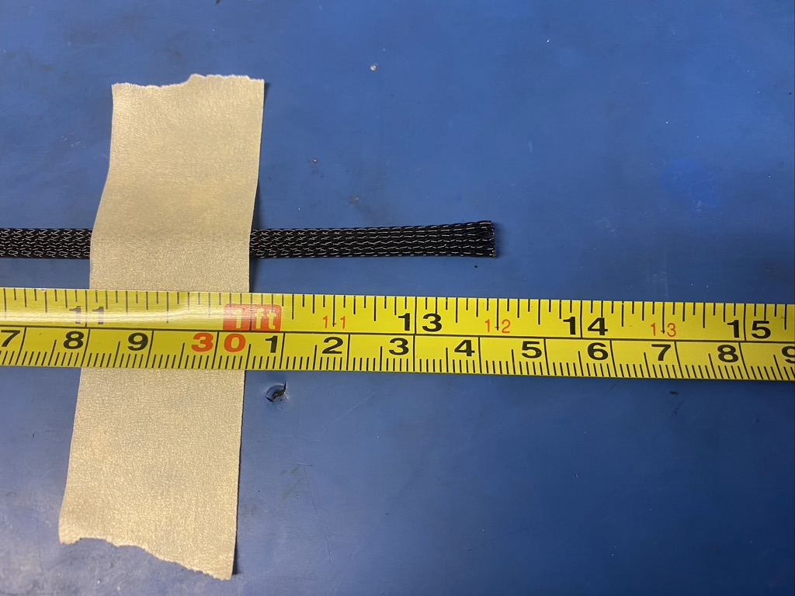
Measure out and cut 13.5 inches of 1/4th plastic braid.

Slide 33
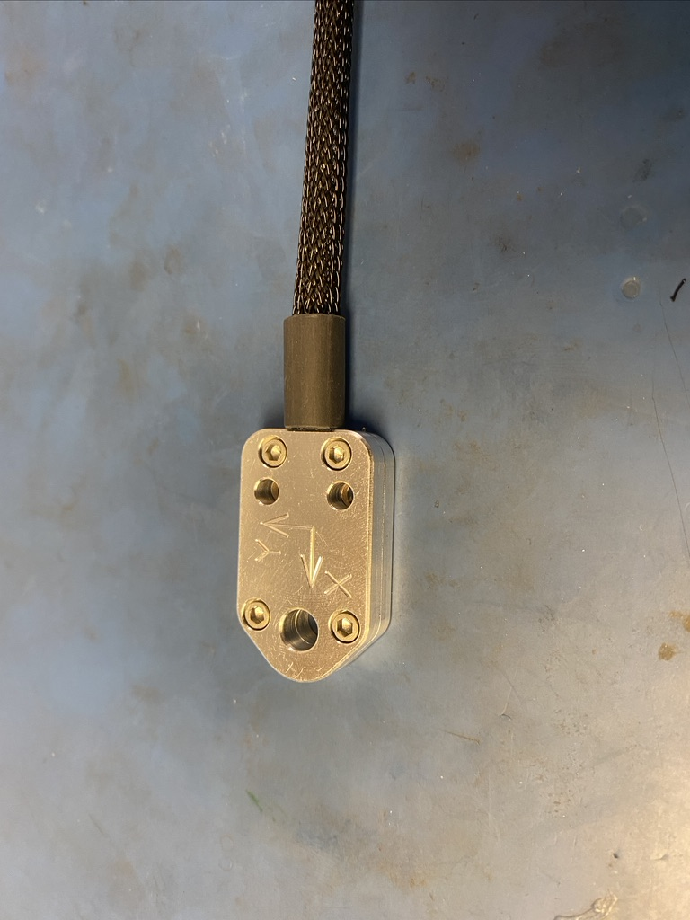
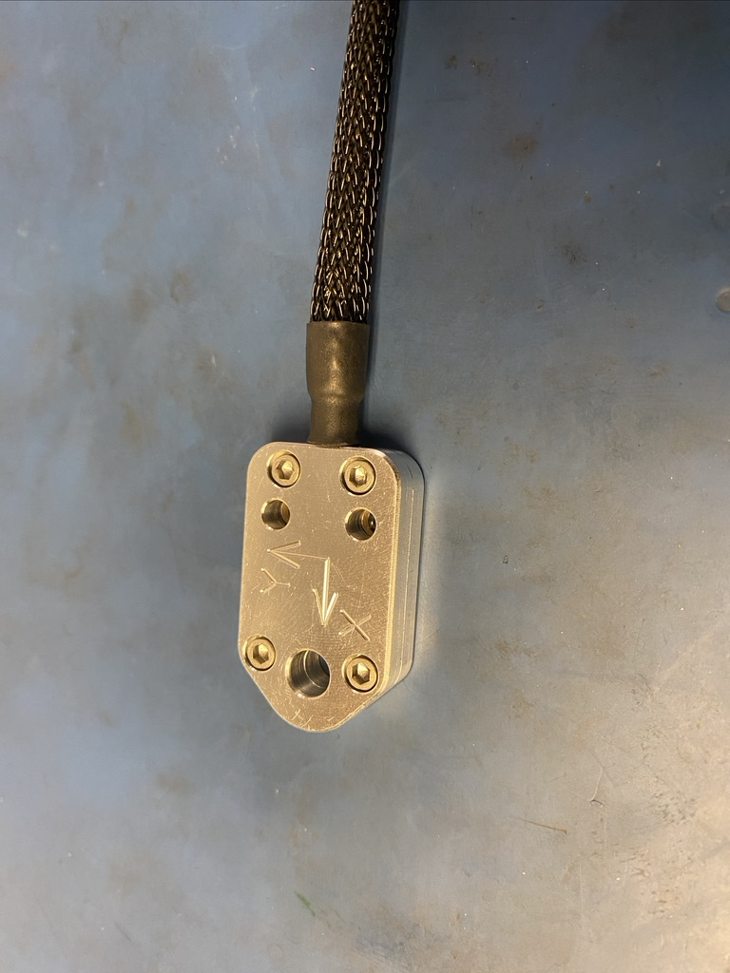
Put the plastic braid onto the ends of the wire and push it all the way to the metal enclosure. Place it under the piece of shrink tube so that it ends midway through it. Apply the heat gun.

Slide 34
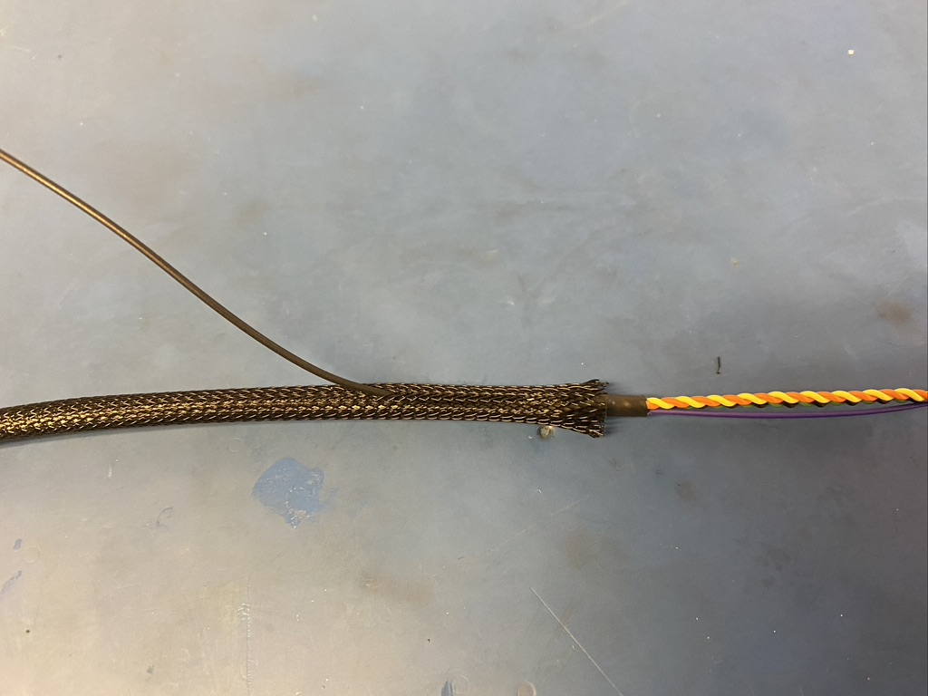
Thread the ground wire through one of the holes in the plastic braid so it appears as shown.

Slide 35
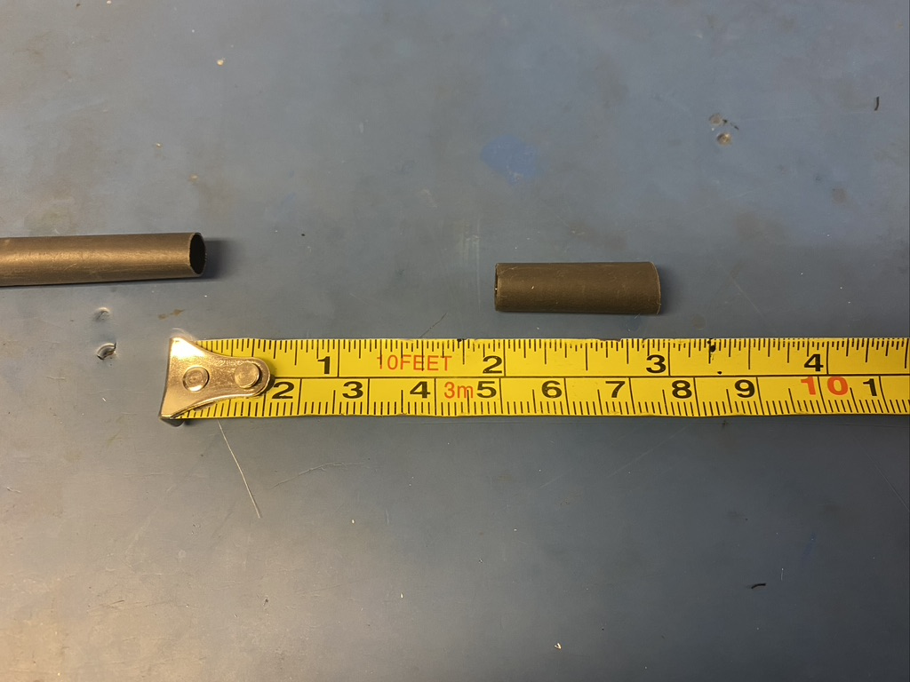
Measure out and cut one length of 6.4mm adhesive shrink tube that is 1in long.

Slide 36
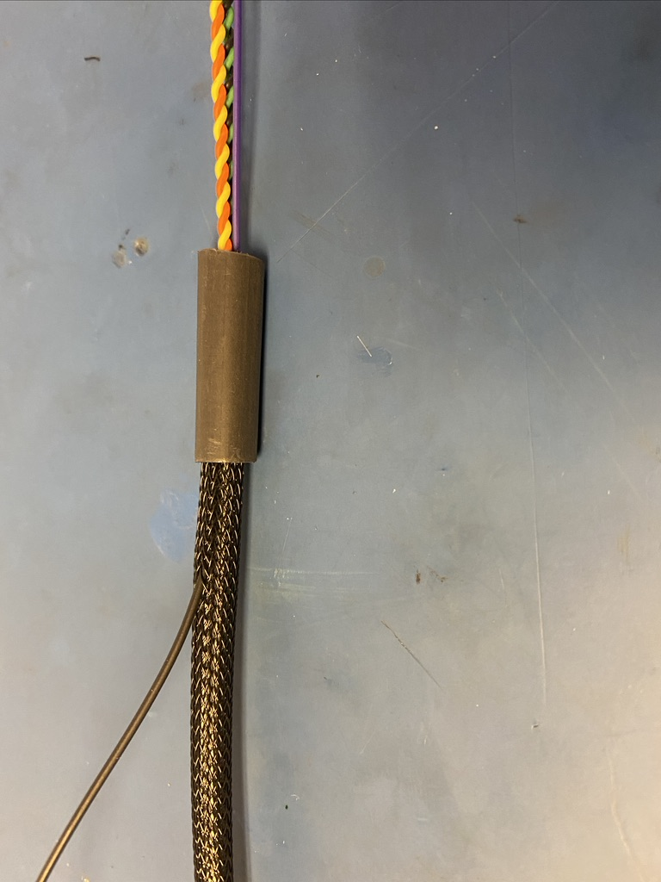
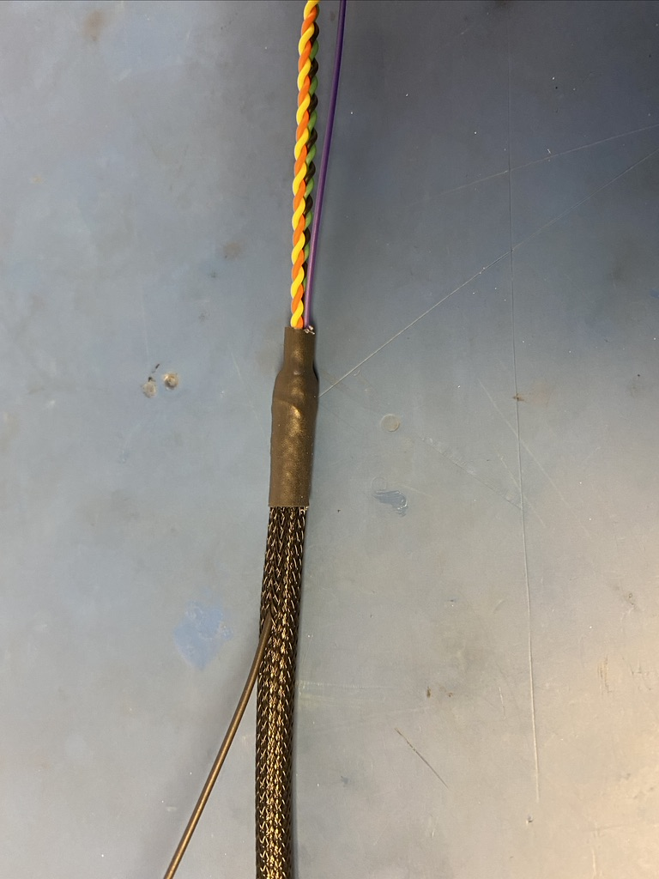
Place the piece of shrink tube onto the ground wire end of the harness. The shrink tube should be placed such that it covers the solder joint and the length of shrink tube beneath. Apply the heat gun.

Slide 37
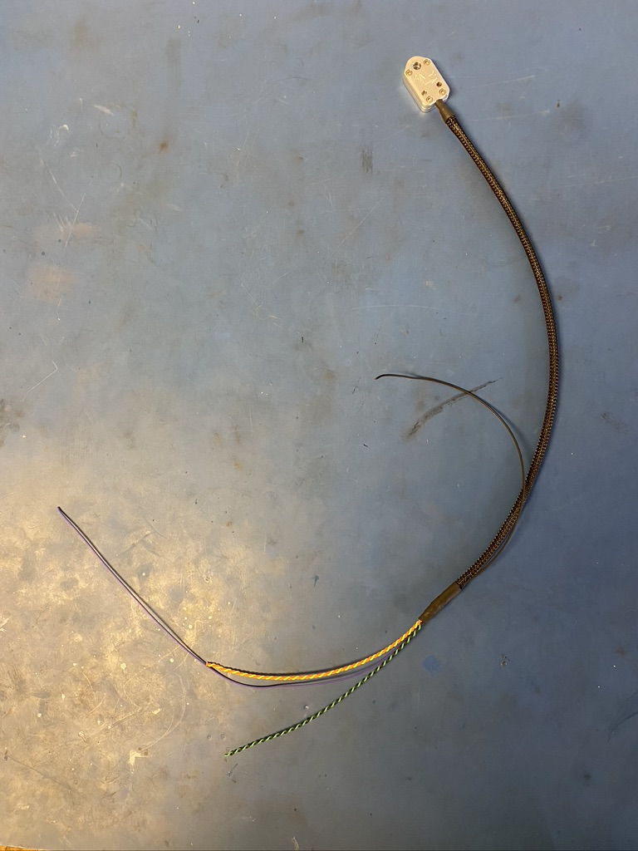
So far, the wire harness should appear as shown on the left.

Slide 38
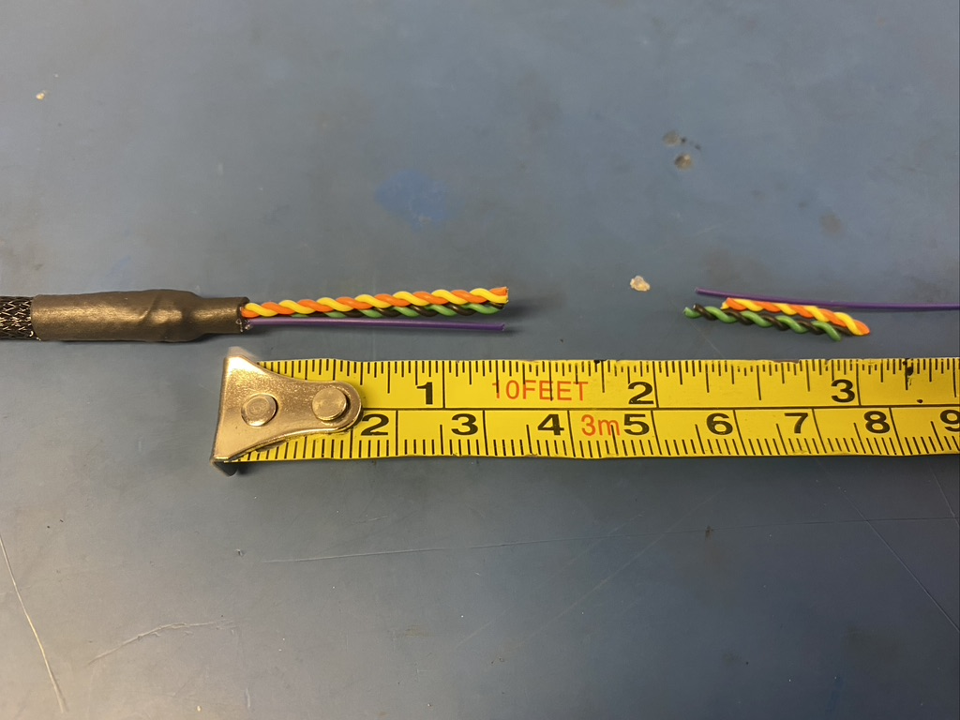
Trim the wire ends to 1.25in long

Slide 39
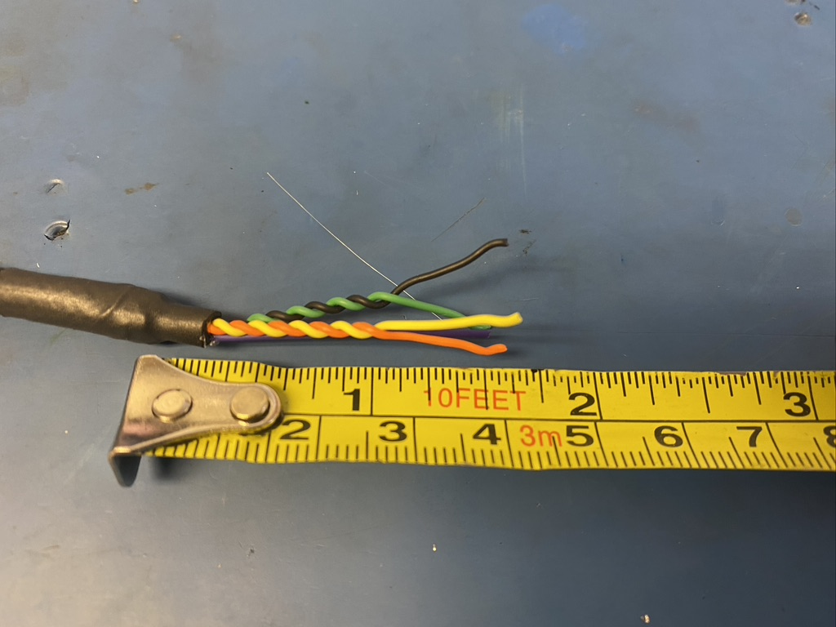
Untwist about .5in of the twisted pairs.

Slide 40


Strip all the wires (3mm). Using the KK 254 crimper, crimp on KK 254 tips. Be sure to use slot A.

Slide 41


Once the wire ends are crimped, they should look as shown: isolation held by the first grip but not the second and a bit of exposed wire peaking out the end of the second grip.

Slide 42


Before inserting the tips into the connector, have the extrusions of both face down. Then push each tip into the hole of the connector until the it clicks. If there are difficulties with pushing the wire tip in by hand, use the metal extraction tool to push on the bottom edge of it until it clicks in place. Please reference the accompanying pin out document to see where each wire should go.
Tip and connector extrusions turned toward table

Slide 43

Once all the wires are inserted, the connector should appear as shown on the left.

Slide 44

Wire harness complete! The ground wire will be given a tip later.

